Slide 1
Microprogrammed Control
M. Balakrishnan
Dept. of Comp. Sci. & Engg.
I.I.T. Delhi

Slide 2
Data-Control Partition
Status
signals
Data
Part
Control
Part
Control
signals

Slide 3
Control Unit Design Options
Adhoc Design
  Combination of MSI & SSI modules
Random logic implementation
  Starting from a state machinedescription
Microprogrammed control
  Starting from a RTL description or even a modified state machine description

Slide 4
Terminology
Microprogram
Microinstruction
Microoperations
Microinstruction format
Microsequencer
Control/Microprogram ROM
Microinstruction register

Slide 5
Block Diagram
Seq
Control
ROM
R
E
G
Data
Part

Slide 6
Microprogrammed Control: Advantages & Disadvantages
Advantages
  Flexible and structured design
  Testing sequences can be easily incorporated
  Easy to document and debug
Disadvantages
  Expensive especially for small designs
  Slower than random logic

Slide 7
Microinstruction Format
1: Data Part Control Signals m
2: Sequencer control/action select k
3: Status control select s
4: Next address n
w (word length) = m + k + s + n
1
2
3
4

Slide 8
Component Sizes
Data Part: m control inputs,
S status outputs
Microsequencer: k+1 inputs, n outputs
Status mux: S status inputs,
s select lines, 1 output
Control ROM: N Χ w bits
Microinst. Reg.: w bits

Slide 9
Labeled Block diagram
Seq
n
Control
ROM
w
R
E
G
m
Data
Part
k
s
1
S
MUX

Slide 10
Clock Period Computation
t_{dp} : Maximum delay in data part
t_{status} : Maximum delay for status gen.
t_{sta_mux} : Delay of status multiplexer
t_{seq} : Microsequencer delay
t_{rom} : Control ROM delay
t_{reg} : Register delay

Slide 11
Performance & Clock Period
t_{clk} ≥ max { t_{dp},
t_{status} + t_{sta_mux} + t_{seq} + t_{rom} + t_{reg}}
Total Time (T) = t_{clk} Χ n_{clk}
Pipelining can be used to decrease the clock period but may also result in increasing the number of clocks.

Slide 12
Microprogrammed Control Design: Example
M. Balakrishnan
Dept. of Comp. Sci. & Engg.
I.I.T. Delhi

Slide 13
Design Steps
Design the datapart and identify the control and status signals
Design the microsequencer based on the branchings required
From the schedule of operations finalize the size of the control ROM
Finalize the microinstruction format
Generate the microprogram

Slide 14
Case Study: GCD Computer
x
z
GCD
Computer
y
eoc
start

Slide 15
GCD Algorithm
s: wait till (start=1);
input x, y; eoc := 0;
while ( x ≠ y ) do
  if ( x > y ) then x := x - y
  else y := y - x
  endif;
  endwhile;
  z := x; eoc := 1; go to s;
  end.

Slide 16
GCD Computer: Data Part
R1
R2
eoc
Comp
R3
SUB

Slide 17
GCD Computer: State Diagram
S0
S1
S2
S3
S5
S4
S6

Slide 18
Control Flow Requirements
Next microinstruction
If (cond) then …
else “m(i + 1)”
cond = {start’, .eq.,.gt.}
Go to “m(0)”

Slide 19
Microsequencer Specifications
Microsequencer instructions
Next (or continue)
Conditional jump
Unconditional Jump

Slide 20
Block Diagram
n
Seq
n
Control
ROM
w
R
E
G
m
Data
Part
k
s
1
S
MUX

Slide 21
Microinstruction Format
Data part control signals
  sel_R1, sel_R2, sel_sub1, sel_seb2, ld_R1, ld_R2, ld_R3, clr_eoc, pr_eoc
Control Part signals
  seq._ins (2 bits), cond_sel(2 bits), Next_adr(3 bits)
Status signals
  start’, .eq., .gt.

Slide 22
Symbolic Microprogram
M0: s_ins = cjmp, c_sel = start’, NA=0
M1: s_R1=x, s_R2 = y, ld_R1, ld_R2, clr_eoc, s_ins = cont
M2: s_ins = cjmp, c_sel = .eq., NA= 6
M3: s_ins = cjmp, c_sel = .gt., NA= 5
M4: sub1= R1, sub2 = R2, ld_R1, s_ins= jp ,NA=2
M5: sub1= R2, sub2 = R1, ld_R2, s_ins= jp, NA = 2
M6: pr_eoc, ld_R3, s_ins = jp, NA = 0

Slide 23
Microsequencer Design
M. Balakrishnan
Dept. of Comp. Sci. & Engg.
I.I.T. Delhi

Slide 24
Microsequencer Design Steps
The role of the microsequencer is to generate the next address.
Enumerate the microsequencer instructions that need to be supported
Identify all the inputs to the “Next Address” multiplexer
Synthesize the logic for the select input of the “Next Address” multiplexer

Slide 25
Microsequencer Synthesis: Example
Microsequencer instructions to be supported
Instruction Encoding
NEXT 0 0
CJMP 0 1
JMP 1 0

Slide 26
“NA” Mux Inputs
μ
P
C
+1
BA
NA
Mux
NA
Cond
Sel Logic
μseq_inst

Slide 27
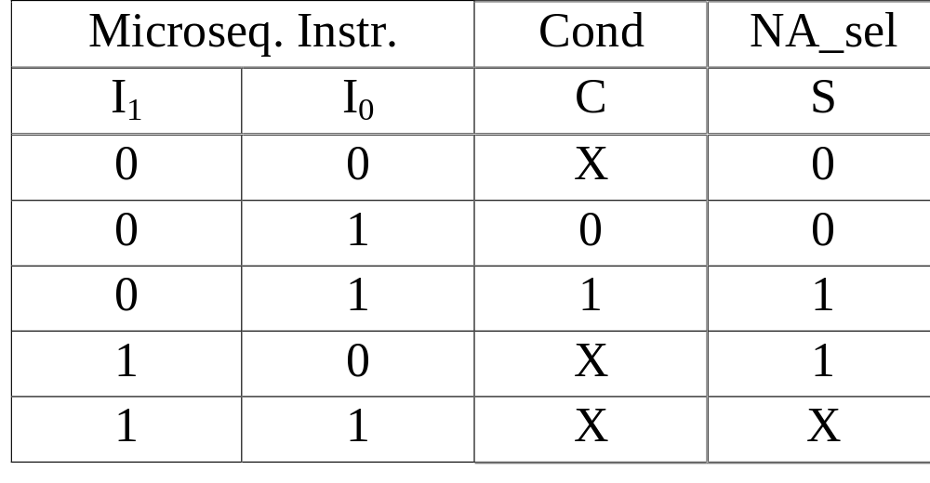
Next Address Select Logic

Slide 28
A Generic Microsequencer
μ
P
C
b
+1
Stack
BA
NA
Mux
NA
Lp
cntr
“0”
Dec 0
Cond
Cond_en
Sel Logic
μseq_inst
OE

Slide 29
Microsequencer Instructions
NEXT (or CONT)
JPC
JMP
JZERO
JSUB
RET
LD_CNTR
RPNZ

Slide 30
Block Diagram
μ
Ins
reg
Data
Part
Control
ROM
μ seq

Slide 31
Timing Diagram
Clk
NA
a
a+1
b
μseq_instr
NEXT
JSUB b
μinstr
MI[a]
MI[a+1]
MI[b]

Slide 32
Multi-way Branching
Multiple address fields
Address mapping through look up tables
Address mapping through address translation and encoding

Slide 33
Multiple Address Fields
j
k
0
1
c3
S_{i}
MUX
BA
c1
c3
c2
Micro-
sequencer
Sta.
mux
S_{i+1}
S_{j}
S_{k}
c2+c3

Slide 34
Multi-way Branching
Mapping ROM
or Address encoding
JMAP instruction
IR
Mapping
ROM
BA
Micro
sequencer

Slide 35
Microprogram Optimization
M. Balakrishnan
Dept. of Comp. Sci. & Engg.
I.I.T. Delhi

Slide 36
Optimization Types
Vertical optimization
Horizontal optimization
Control ROM
m X n

Slide 37
Vertical Optimization
Rescheduling or reassignment of control signals to control steps/microinstructions
Merging of microinstructions
Timing isssues

Slide 38
Horizontal Optimization
Reducing the width of microinstructions
  Compromising on the available concurrency in the data/control part
  Without compromising the concurrency available
Encode multiple microoperations/control signals in the same field

Slide 39
Microinstruction Formats
Horizontal format
  Separate bits (/fields) for all control signals (/microoperations)
  No loss of concurrency
  Large width of microinstructions and low utilization

Slide 40
Microinstruction Format (contd.)
Vertical format
  Only one microoperation (or register transfer operation) per microinstruction
  Difinite loss of concurrency
  Smallest possible width of microinstructions and very high utilization

Slide 41
Microinstruction Format (contd.)
Minimally encoded format
  Multiple microoperations (or register transfer operation) per microinstruction
  Concurrency may or may not be compromised
  Architecture driven or application driven encoding

Slide 42
Encoding Example
En_A
A
En_B
B
En_C
C
Ld_D
Ld_E
Ld_E
D
E
F

Slide 43
Horizontal Format
En_A En_B En_C Ld_D Ld_E Ld_F

Slide 44
Vertical Format
0000 No Operation
0001 Transfer_A_D
……
1001 Transfer_C_F
Transfer _ X _ Y

Slide 45
Minimal Encoding
Architecture Dependent
Bus_Src
00 A
01 B
10 C
Bus_Src Ld_D Ld_E Ld_F

Slide 46
Minimal Encoding (contd.)
Application Dependent
Bus_Src Bus_Dest
00 A 00 Noop
01 B 01 D & E
10 C 10 E
11 F
Bus_Src Bus_Dest

Slide 47
Impact of Encoding
Cost
  Reduction in the control ROM size
  Additional decoders
Performance
  Increase in the clock period if the decoders are in the critical path

Slide 48
Complex Microinstruction Encoding & Formats
Multiple level encoding
Nanoprogramming

Slide 49
Microinstruction Optimization
M. Balakrishnan
Dept. of Comp. Sci. & Engg.
I.I.T. Delhi

Slide 50
Input-Output Specification
Inputs: A horizontal microinstruction format
Symbolic microprogram
Output: Microinstruction format

Slide 51
GCD Example
s: wait till (start=1);
input x, y; eoc := 0;
while ( x ≠ y ) do
  if ( x > y ) then x := x - y
  else y := y - x
  endif;
  endwhile;
  z := x; eoc := 1; go to s;
  end.

Slide 52
Symbolic Microprogram
1 Sta_s, Seq_i, BA
2 R1_s, R1_ld, R2_s, R2_ld, eoc_c, Seq_i
3 Sta_s, Seq_i, BA
4 Sta_s, Seq_i, BA
5 Sub1_s, Sub2_s, R1_s, R1_ld, Seq_I, BA
6 Sub1_s, Sub2_s, R2_s, R2_ld, Seq_I, BA
7 eoc_p, R3_ld, Seq_i, BA

Slide 53
Horizontal Format
A = Sta_s (2) B = Seq_I (2) C = BA(3)
D = R1_s E = R1_ld F = R2_s
G = R2_ld H = eoc_c I = S1_s
J = S2_s K = R3_ld L = eoc_p
Microinstruction word length = 16

Slide 54
Disjoint Graph
A
B
C
L
K
D
J
E
I
F
H
G

Slide 55
Microinstruction Formats
{A,B,C,D,E,F,G,H,I,J,K,L} 16
{(A,D,L),B,(C,H),(E,K),F,G,I,J} 13

Slide 56
Reflecting Control Signal Properties
Non-linear cost reduction due to encoding
  Reflect in “cost” computation
Nature of control signals: default value is fixed or don’t care
  Mark the nodes and reflect in clustering
Width of control signals
  Multiple copies of the same node with bit number

Slide 57
Modified Disjoint Graph
A
B
C
L
K
D
J
E
I
F
H
G

Slide 58
Additional Microinstruction Formats
{A,B,C,D,E,F,G,H,I,J,K,L} 16
{(A,D,L),B,(C,H),(E,K),F,G,I,J} 13
{(A1,E),(A2,G),B1,B2,(C1,H),C2,C3,
(I,L),(J,K)} 9

Slide 59
Column Compatibility
Based on the optimized format, generate the binary microprogram
Based on the compatibility between columns, draw the compatibility graph
Again apply clique partitioning to eliminate redundant columns

Slide 60
Microinstruction Optimization Steps
Generate the symbolic microprogram
Design a horizontal microinstruction format
Optimize to generate the fields in the optimized format
Generate binary microprogram
Eliminate redundant columns
Design the decoders and fanout logic

